Slide 1
Joined Relations
Join operations take two relations and return as a result another relation.
A join operation is a Cartesian product which requires that tuples in the two relations match (under some condition). It also specifies the attributes that are present in the result of the join
Joins are:
  Inner join
  Left Outer join
  Right Outer Join
  Full Outer Join

Slide 2
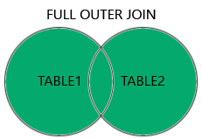
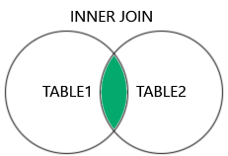
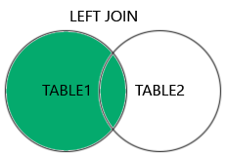
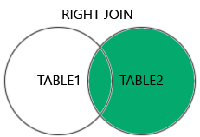
Outer Join
An extension of the join operation that avoids loss of information.
Computes the join and then adds tuples form one relation that does not match tuples in the other relation to the result of the join.
Uses null values.
joins:
  Inner Join
  left outer join
  right outer join
  full outer join

Slide 3


Outer Join Example Tables
course relation
prereq relation
Observe that
course information is missing CS-347
prereq information is missing CS-315

Slide 4
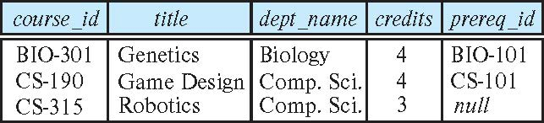
Left Outer Join
General structure
  <table 1> natural left outer join <table 2>
Example
  course natural left outer join prereq
  Add to the course relation (on the left) the relevant info from prereq
    Since CS-315 does not appear in prereq we use null for prereq_id
    In relational algebra syntax:
    course ⟕ prereq

Slide 5
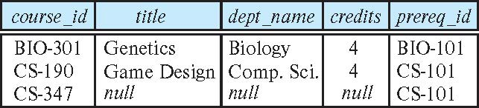
Right Outer Join
course natural right outer join prereq
Add to the prereq relation (on the right) the relevant info from course
  In relational algebra:
  course ⟖ prereq

Slide 6
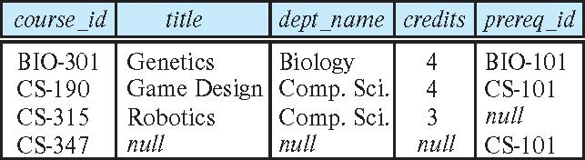
Full Outer Join
course natural full outer join prereq
In relational algebra:
course ⟗ prereq

Slide 7
Views and Authorization

Slide 8
Views
In some cases, it is not desirable for all users to see the entire logical model (that is, all the actual relations stored in the database.)
Consider a person who needs to know an instructors name and department, but not the salary. This person should see a relation described, in SQL, by
select ID, name, dept_name
from instructor
A view provides a mechanism to hide certain data from the view of certain users.
Any relation that is not of the conceptual model but is made visible to a user as a “virtual relation” is called a view.

Slide 9
View Definition
A view is defined using the create view statement which has the form
create view v as < query expression >
where <query expression> is any legal SQL expression. The view name is represented by v.
Once a view is defined, the view name can be used to refer to the virtual relation that the view generates.
View definition is not the same as creating a new relation by evaluating the query expression
  Rather, a view definition causes the saving of an expression; the expression is substituted into queries using the view.

Slide 10
Example Views
A view of instructors without their salary
create view faculty as
select ID, name, dept_name
from instructor
Find all instructors in the Biology department
select name
from faculty
where dept_name = ‘Biology’
Create a view of department salary totals
create view departments_total_salary(dept_name, total_salary) as
select dept_name, sum (salary)
from instructor
group by dept_name;

Slide 11
Views Defined Using Other Views
create view physics_fall_2009 as
select course.course_id, sec_id, building, room_number
from course, section
where course.course_id = section.course_id
and course.dept_name = ’Physics’
and section.semester = ’Fall’
and section.year = ’2009’;
create view physics_fall_2009_watson as
select course_id, room_number
from physics_fall_2009
where building= ’Watson’;

Slide 12
Materialized Views
Materializing a view: create a physical table containing all the tuples in the result of the query defining the view
If relations used in the query are updated, the materialized view result becomes out of date
  Need to maintain the view, by updating the view whenever the underlying relations are updated.

Slide 13
Integrity Constraints
Integrity constraints guard against accidental damage to the database, by ensuring that authorized changes to the database do not result in a loss of data consistency.
  A checking account must have a balance greater than $10,000.00
  A salary of a bank employee must be at least $4.00 an hour
  A customer must have a (non-null) phone number

Slide 14
Integrity Constraints on a Single Relation
not null
primary key
unique
check (P), where P is a predicate

Slide 15
Not Null and Unique Constraints
not null
  Declare name and budget to be not null
name varchar(20) not null
budget numeric(12,2) not null
unique ( A₁, A₂, …, A_{m})
  The unique specification states that the attributes A1, A2, … Am
  form a candidate key.
  Candidate keys are permitted to be null (in contrast to primary keys).

Slide 16
The check clause
check (P)
where P is a predicate
Example: ensure that semester is one of fall, winter, spring or summer:
create table section (
course_id varchar (8),
sec_id varchar (8),
semester varchar (6),
year numeric (4,0),
building varchar (15),
room_number varchar (7),
time slot id varchar (4),
primary key (course_id, sec_id, semester, year),
check (semester in (’Fall’, ’Winter’, ’Spring’, ’Summer’))
);

Slide 17
Referential Integrity
Ensures that a value that appears in one relation for a given set of attributes also appears for a certain set of attributes in another relation.
  Example: If “Biology” is a department name appearing in one of the tuples in the instructor relation, then there exists a tuple in the department relation for “Biology”.
Let A be a set of attributes. Let R and S be two relations that contain attributes A and where A is the primary key of S. A is said to be a foreign key of R if for any values of A appearing in R these values also appear in S.

Slide 18
Given the following relational schema
Course (course-id, title, dept_name, credit)
Department (dept_name, building, budget)
Define SQL DDL for the above relational schema to implement the following constraints
Course-id must not be null and must be unique
Dept_name must not be null and must be unique
If a dept_name is updated in department relation, it will update the dept_name of all courses in the course relation
If a dept_name is deleted in department relation, it will delete all courses of that department from the course relation
A dept_name cannot be inserted into course table that dept-_name is not present in department table.

Slide 19
Cascading Actions in Referential Integrity
create table course (
course_id char(5) primary key,
title varchar(20),
dept_name varchar(20) references department
)
create table course (
…
dept_name varchar(20),
foreign key (dept_name) references department
on delete cascade
on update cascade,
. . .
)
alternative actions to cascade: set null, set default

Slide 20
Users Management
There are following types of users
  Students (S1, S2, .............. Sn)
  Instructors (I1, I2, I3, ............. Im)
  Advisers (Ad1, Ad2, ....... Adk)
  Head of the Department (HoD1, HoD2 ...... HoDp)
Students can add courses
Advisors approve courses, delete advisee courses , add advisee courses
Instructors can add courses to be taught, delete courses already selected to be taught
Head of the department can add new courses, approve actions of advisors and instructors

Slide 21
Authorization
Forms of authorization on parts of the database:
Read - allows reading, but not modification of data.
Insert - allows insertion of new data, but not modification of existing data.
Update - allows modification, but not deletion of data.
Delete - allows deletion of data.
Forms of authorization to modify the database schema
Index - allows creation and deletion of indices.
Resources - allows creation of new relations.
Alteration - allows addition or deletion of attributes in a relation.
Drop - allows deletion of relations.

Slide 22
Authorization Specification in SQL
The grant statement is used to confer authorization
grant <privilege list>
on <relation name or view name> to <user list>
<user list> is:
  a user-id
  public, which allows all valid users the privilege granted
  A role (more on this later)
Granting a privilege on a view does not imply granting any privileges on the underlying relations.
The grantor of the privilege must already hold the privilege on the specified item (or be the database administrator).

Slide 23
Privileges in SQL
select: allows read access to relation,or the ability to query using the view
  Example: grant users U₁, U₂, and U₃ select authorization on the instructor relation:
grant select on instructor to U₁, U₂, U₃
insert: the ability to insert tuples
update: the ability to update using the SQL update statement
delete: the ability to delete tuples.
all privileges: used as a short form for all the allowable privileges

Slide 24
Revoking Authorization in SQL
The revoke statement is used to revoke authorization.
  revoke <privilege list>
  on <relation name or view name> from <user list>
Example:
  revoke select on branch from U₁, U₂, U₃
<privilege-list> may be all to revoke all privileges the revokee may hold.
If <revokee-list> includes public, all users lose the privilege except those granted it explicitly.
If the same privilege was granted twice to the same user by different grantees, the user may retain the privilege after the revocation.
All privileges that depend on the privilege being revoked are also revoked.

Slide 25
Roles
create role instructor;
grant instructor to Amit;
Privileges can be granted to roles:
  grant select on takes to instructor;
Roles can be granted to users, as well as to other roles
  create role teaching_assistant
  grant teaching_assistant to instructor;
    Instructor inherits all privileges of teaching_assistant
Chain of roles
  create role dean;
  grant instructor to dean;
  grant dean to Satoshi;

Slide 26
Authorization on Views
create view geo_instructor as
(select *
from instructor
where dept_name = ’Geology’);
grant select on geo_instructor to geo_staff
Suppose that a geo_staff member issues
  select *
  from geo_instructor;
What if
  geo_staff does not have permissions on instructor?
  creator of view did not have some permissions on instructor?

